Slide 1
CG1 Labs
Wei Li

Slide 2
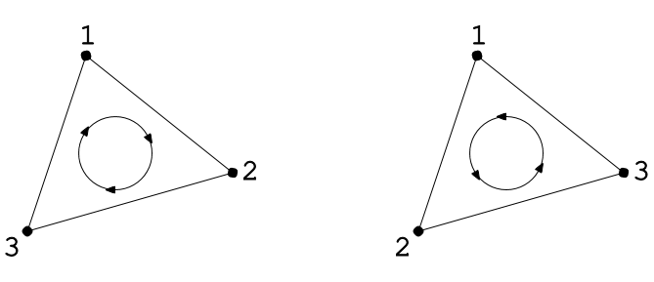
Back Face Culling
// enable back-face culling
glEnable( GL_CULL_FACE );
// orientation of front-facing polygons
glFrontFace( GL_CCW );
… draw something …
glFrontFace( GL_CW );
… draw something …

Slide 3
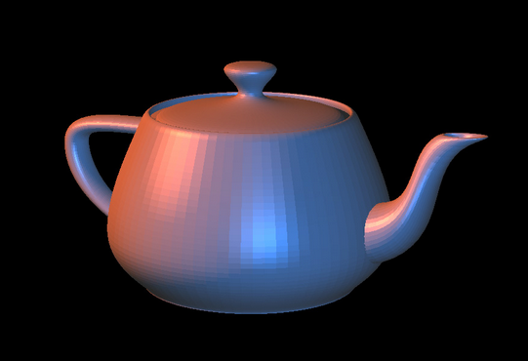
Lighting
// enable lighting
glEnable(GL_LIGHTING);
// enable first light source
glEnable(GL_LIGHT0);
… setup light source attributes …
… setup surface material attributes …
… draw meshes …

Slide 4
Light Source Type
Point Light : ( 5.30, 8.60, 2.07, 1 )
Parallel Light : ( 0.46, 0.69, 0.54, 0 )
Spot Light : angle
Attenuation : 1 / ( ax² + bx + c )

Slide 5
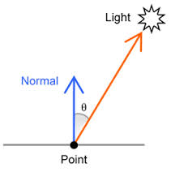
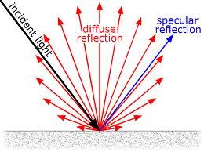
Shading Component
Diffuse
Specular
Ambient

Slide 6
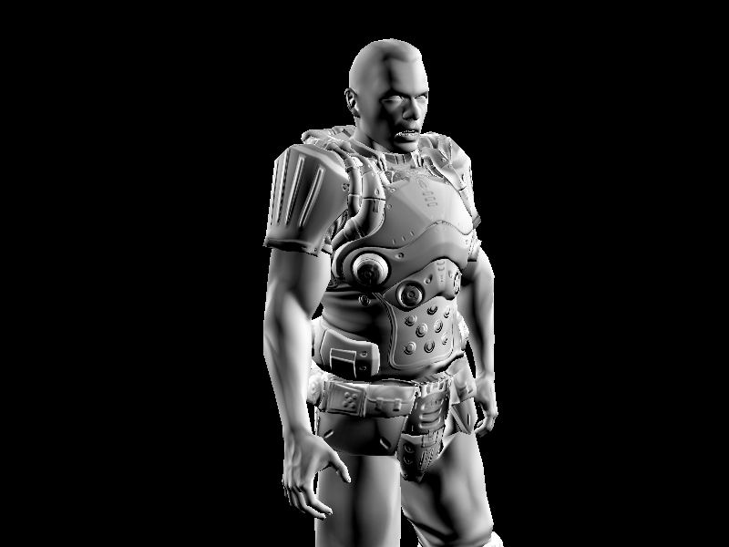
Diffuse

Slide 7
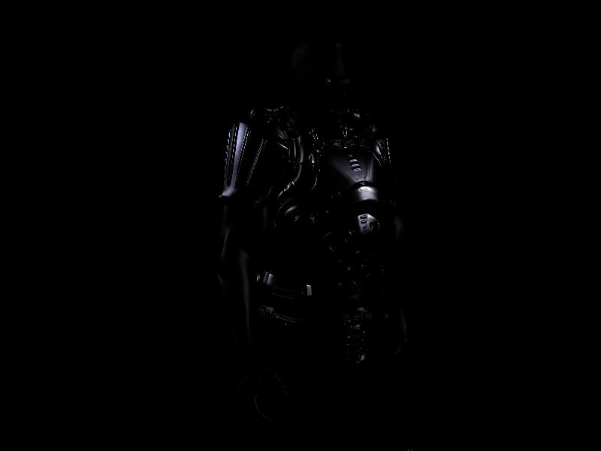
Specular

Slide 8
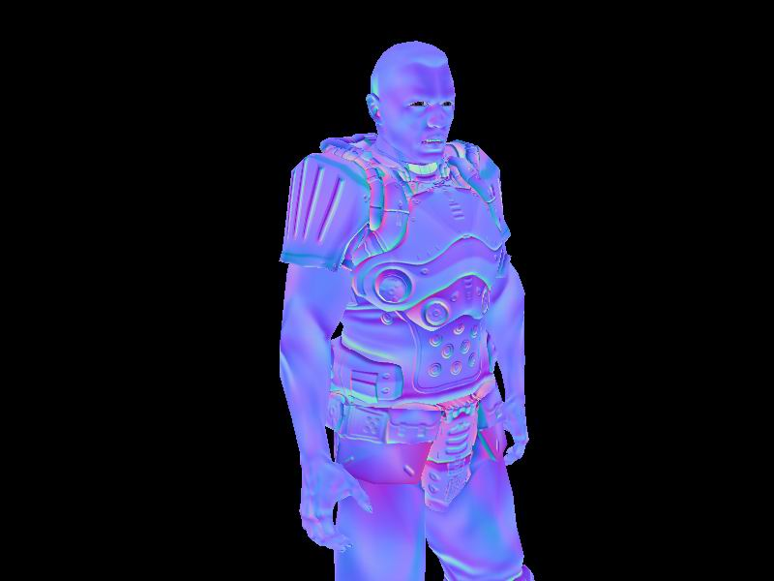
Normal

Slide 9
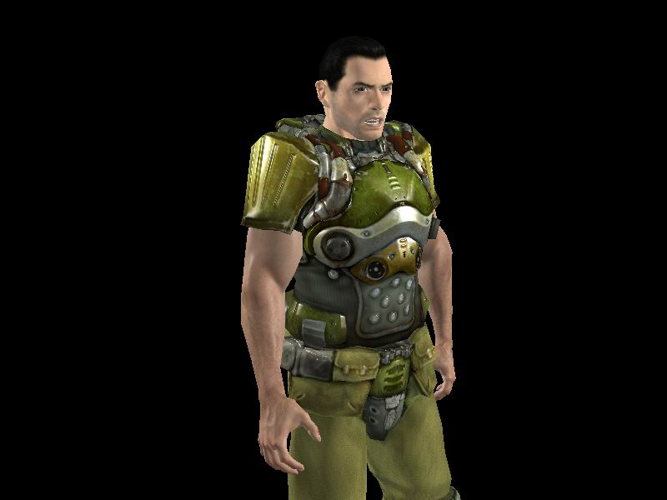
Result

Slide 10
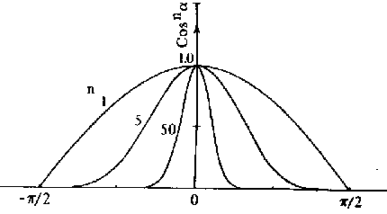
// light source attributes
GLfloat LightAmbient [] = { 0.4f, 0.4f, 0.4f, 1.0f };
GLfloat LightDiffuse [] = { 0.3f, 0.3f, 0.3f, 1.0f };
GLfloat LightSpecular [] = { 0.4f, 0.4f, 0.4f, 1.0f };
GLfloat LightPosition [] = { 5.0f, 5.0f, 5.0f, 1.0f };
glLightfv(GL_LIGHT0, GL_AMBIENT , LightAmbient );
glLightfv(GL_LIGHT0, GL_DIFFUSE , LightDiffuse );
glLightfv(GL_LIGHT0, GL_SPECULAR , LightSpecular);
glLightfv(GL_LIGHT0, GL_POSITION , LightPosition);
Shininess
specifies how small the highlights are

Slide 11
// surface material attributes
GLfloat material_Ka [] = { 0.11f, 0.06f, 0.11f, 1.0f };
GLfloat material_Kd [] = { 0.43f, 0.47f, 0.54f, 1.0f };
GLfloat material_Ks [] = { 0.33f, 0.33f, 0.52f, 1.0f };
GLfloat material_Ke [] = { 0.10f, 0.00f, 0.10f, 1.0f };
GLfloat material_Se = 10;
glMaterialfv(GL_FRONT_AND_BACK, GL_AMBIENT, material_Ka);
glMaterialfv(GL_FRONT_AND_BACK, GL_DIFFUSE, material_Kd);
glMaterialfv(GL_FRONT_AND_BACK, GL_SPECULAR, material_Ks);
glMaterialfv(GL_FRONT_AND_BACK, GL_EMISSION, material_Ke);
glMaterialf (GL_FRONT_AND_BACK, GL_SHININESS, material_Se);

Slide 12
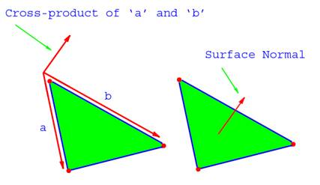
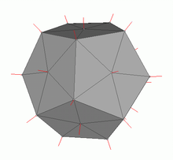
Draw Polygon with Normals
glBegin( GL_POLYGON );
// vertex 1
glNormal3f( nx1, ny1, nz1 );
glVertex3f( x1, y1, z1 );
// vertex 2
glNormal3f( nx2, ny2, nz2 );
glVertex3f( x2, y2, z2 );
…
glEnd();

Slide 13
Gen Texture
// gen texture
Gluint tex = 0;
glGenTextures ( 1, &tex );
// Load Texture Image
Int sizex = 512;
Int sizey = 512;
unsigned char *pixels = new unsigned char[ sizex * sizey * 3 ]; // RGB
… load image data to pixel buffer …
glBindTexture( GL_TEXTURE_2D, tex );
glTexImage2D(
GL_TEXTURE_2D, // target
0, // level
GL_RGBA8, // internal format
sizex, sizey, // texture size
0, // border
GL_RGB, // image format
GL_UNSIGNED_BYTE, // image data type
pixels // pointer to image pixel buffer
);
glBindTexture( GL_TEXTURE_2D, 0 );

Slide 14
Use Texture
// enable texture mapping and bind texture
glEnable( GL_TEXTURE_2D );
glBindTexture( GL_TEXTURE_2D, tex );
// setup texture filter
glTexParameteri( GL_TEXTURE_2D, GL_TEXTURE_MIN_FILTER, GL_LINEAR );
glTexParameteri( GL_TEXTURE_2D, GL_TEXTURE_MAG_FILTER, GL_LINEAR );
// draw polygon with texture coordinate
…
// disable texture mapping and unbind texture
glBindTexture( GL_TEXTURE_2D, 0 );
glDisable( GL_TEXTURE_2D );

Slide 15
GL_NEAREST vs GL_LINEAR

Slide 16
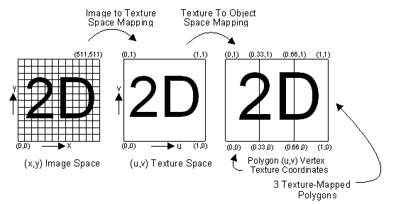
Draw Polygon with Texture Coordinate
glBegin( GL_POLYGON );
// vertex 1
glTexCoord2f( s1, t1 );
glVertex3f( x1, y1, z1 );
// vertex 2
glTexCoord2f( s2, t2 );
glVertex3f( x2, y2, z2 );
…
glEnd();

Slide 17
Delete Texture
glDeleteTextures( 1, &tex );
tex = 0;

Slide 18
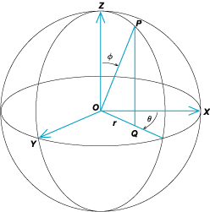
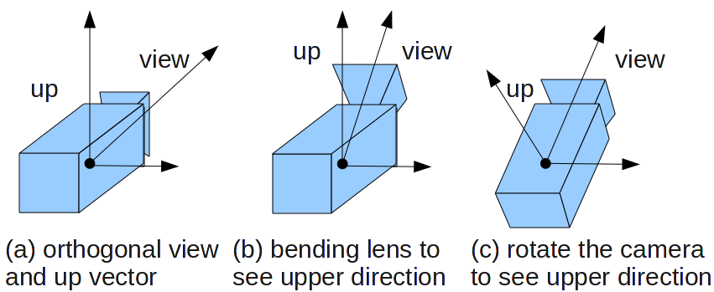
Spherical Coordinates
Pitch ( around right axis )
Yaw ( around gravity axis )

Slide 19
Model
.d File should start from “data”, no preceding space, like “ data”
Indices start from 1 or 0
C++
C++ is not like C# or Java which has garbage collector
so if you "new" something, remember to "delete" it
// array
int *indices = new int[ 128 ];
delete[] indices;
Indices = NULL;
// instance
vec3 *vp = new vec3;
delete vp;
vp = NULL;
For simple instance, you can just define it in this way
vec3 v;

Slide 20
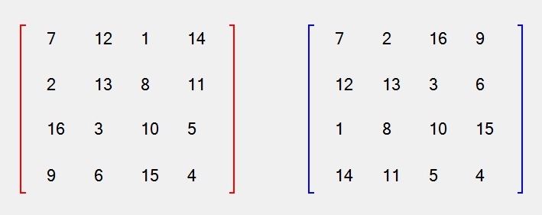
OpenGL Matrix
glMatrixMode( GL_MODELVIEW ); // ?
glLoadIdentity(); // I
glTranslatef(); // I * T
glRotatef(); // I * T * R
glPushMatrix(); // I * T * R -> stack
glMultMatrix(); // I * T * R * M
…
glVertex3f(); // I * T * R * M * v
…
glPopMatrix(); // stack -> I * T * R
glVertex3f(); // I * T *R * v
Column Major vs. Row Major

